Slide 1





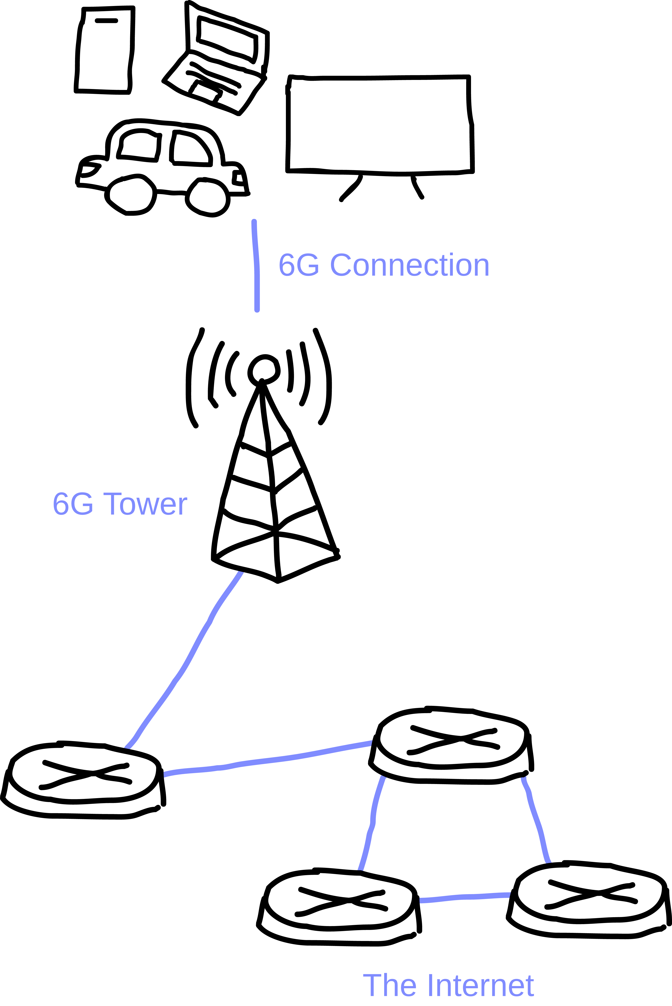
BLAST 2: The Basics of the 6th Generation of cellular network technology
James Bruxvoort
Computer Networking and Communication, Fall 2026
Faculty Sponsor: Dr. Victor Govindaswamy
Concordia University Chicago
Abstract
Connection to wider concepts
Protocol Layer Connection
Current Status
There are many technologies in our world that would be seen as “coming soon”, one of which being the 6th Generation of cellular networks, also known more commonly as simply “6G”, which this poster goes over some of the basics of. As the name might imply, it’s meant as a replacement for the current 5th generation, promising improved capabilities in range of where a device is used and how many devices are used, as well as far greater energy efficiency. As such, it finds itself at home within the link layer of the internet protocol stack, helping bridge the gap between the physical and the network.
Its method of doing so is various radio waves broadcasted from compatible cell towers, which transfers data both to the users, as well as from users back up to the network. Based on research, one possible real-world application for 6G is within farming, as it allows for the use of reliable real-time internet in previously rural areas that required pit stops at a hot spot to update any data. This is certainly one of its biggest benefits by far and allows for the creation and usage of more smart technologies to improve our lives, even in rural areas, an improvement that’s much more than just the obvious “everything is faster now”.
Of course, we still lack the tech to ultimately set it up unfortunately, and there’s bound to be a backlash to any standardization attempts, just as there was with the construction of 5G. It’s also still in just the experimental stages, with any rollout of it to any party having yet to begin. However, the amount of change it could bring by rolling out the proverbial red carpet for other technologies and future networking advancements is an insane impact, and all the more reason to seek it out.
Given its purpose as an upgrade for our current 5G cellular, 6G immediately connects with many basic topics already associated with it. Its increased capabilities allows for an improved throughput and similarly increases the number of devices needed to start causing congestion. In turn, this also helps reduce delay, as well as any packet loss that may occur as a result of delays.
Application
Transport
Network
Link | ←6G is here
Physical
Right now, I would consider it to be experimental. Yes, a large portion of the tech for it, as well as the guidelines for how it’ll be used, is being actively determined as we speak. However, that’s just it. It’s still being determined. An active rollout of any technology, even to just the Upper Class, has not yet occurred.
Future Impact
Emerging Technology
This drastically improves the capabilities of 5G, as well as lessening its strain thanks to improved energy efficiency. In turn, this opens up the door to other possibilities such as various AIs embedded within the network to perform various tasks, such as managing traffic. Along with that, it allows for increased usage, and areas of usage of networking, hopefully reducing the amount of areas with zero cell service.
6G is the Sixth Generation of cellular network technology, replacing the currently implemented 5G in the Link layer of networking. It is, for all intents and purposes, an improved version of 5G, hence being the sixth generation, and not just a minor update to the fifth. As expected from this, its main purpose is to help connect users to the network layer of the internet.
6G’s goal is connecting people to the world wide web. As such, in the Internet Protocol Stack, it finds itself in the link layer.
Real World Application
One real-world application of 6G is its use for farming. At the moment, the rural nature of farming can often mean no Internet, or connectivity to the Cloud. As such, any internet-related activities requires edge computing servers to serve as pitstops, something that can be a hindrance to anything that needs real-time coordination, such as the harvest season. The presence of 6G, and its wider range than 5G, allows for the uploading of data from anywhere without the need for a pit stop, allowing technology to become far more valuable in farming.
How it Works
Conclusion
The way 6G works is that it functions as a base station, acting as the middleman between the various physical devices we use that make up the internet’s edge, and the network where all the data, documents, and memes are stored. From there, Cell Towers are used to transport bits and bytes of data through the means of various frequencies and wavelengths of radio waves, sending data from the network to any devices that make use of cellular data, as well as collecting any data or action these devices may want to use or perform, and thusly sending them on their way into the internet.
The improvements this has over our current 5G is insane, and opens the door to many new ways to make a brighter future with the help of technology, even with just “no more dead spots”, and nothing crazy like AI networking or Quantum networking, or something of the sort. The biggest takeaway you can have from this is the fact that 6G will allow us to connect more things, in more places, with more new technologies.
Benefits
Works Cited
The biggest benefits to 6G is just how much more effective it’d be than 5G. It can handle 100x the density of connections that 5G can, and runs with 100x the energy efficiency. Latency drops to a fraction. Mobility doubles, and the Frequency Bandwidth, as well as the Data Rate, also both massively increase. This all matters so much not just because “oh boy everything is faster now”, it’s because it opens the door to so many new possibilities, and acts as the stepping stone for many potential new technologies that 5G just can’t handle, such as AI-assisted Networking. Furthermore, the ability to hold more items at once incentivizes and allows for a far wider reach for cell service.
E. Yaacoub and M.-S. Alouini, “A Key 6G Challenge and Opportunity—Connecting the Base of the Pyramid: A Survey on Rural Connectivity,” Proceedings of the IEEE, vol. 108, no. 4, pp. 533–582, 2020, doi: 10.1109/JPROC.2020.2976703.
H. Tataria, M. Shafi, A. F. Molisch, M. Dohler, H. Sjöland, and F. Tufvesson, “6G Wireless Systems: Vision, Requirements, Challenges, Insights, and Opportunities,” Proceedings of the IEEE, vol. 109, no. 7, pp. 1166–1199, 2021, doi: 10.1109/JPROC.2021.3061701.
K. B. Letaief, W. Chen, Y. Shi, J. Zhang, and Y.-J. A. Zhang, “The Roadmap to 6G: AI Empowered Wireless Networks,” IEEE Communications Magazine, vol. 57, no. 8, pp. 84–90, 2019, doi: 10.1109/MCOM.2019.1900271.
M. Giordani, M. Polese, M. Mezzavilla, S. Rangan, and M. Zorzi, “Toward 6G Networks: Use Cases and Technologies,” IEEE Communications Magazine, vol. 58, no. 3, pp. 55–61, 2020, doi: 10.1109/MCOM.001.1900411.
R. Chataut, M. Nankya, and R. Akl, “6G Networks and the AI Revolution—Exploring Technologies, Applications, and Emerging Challenges,” Sensors, vol. 24, no. 6, 2024, doi: 10.3390/s24061888.
Youtube Overview
BLAST Repository
Network Architecture / Design Diagram
Networking Problem / Motivation
The purpose of 6G is to address the limitations of 5G, drastically improving its capabilities and reach in order to pave the way for other future networking technologies such as AI, or simply the connection of a greater number of devices in a larger area.
Limitations / Challenges
Of course, there are likely to be a few limitations and challenges with a standardized 6G network. The biggest one is simply implementation. We lack the tech necessary to fully set it up, and along with that, it has far more range than 5G, which already had issues with its construction and the backlash over potential health risks.
Background
For understanding talk of 6G, a baseline knowledge of Layered internet protocol stack, and cellular data is recommended for the understanding of 6G

